Slide 1

Presentation
Capstone Design – MS
Instructor/Professor
PARK DONG JOO
Team Members
JUNG WOO SEOP (32184140)
BAEK MIN JAE (32171972)
SEO DONG HWAN (32182108)
WI JUNG MYUNG (32182779)
LEE DABIN (32172917)
Team Name
Manners Maketh Man

Slide 2
Why we need the problem solving
Communication
Problems
Current status
Market forecast
Solution proposal
Solution overview
Focusing part and why
KPI
Proposal of the implementation method
Capability matching
Structure of the team development
Time plan
Risk analysis and hedging
Utilization of the result
A marketing plan for target customers
Impact analysis to industry/society
Contents

Slide 3

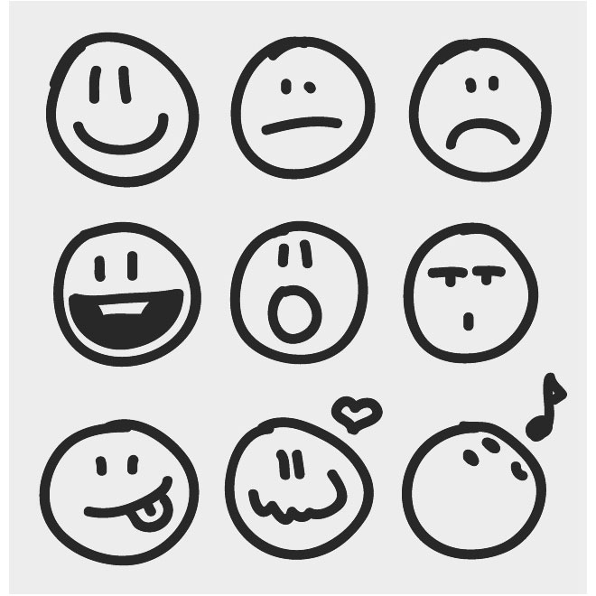


1. Why we need the problem solving
1-a. Communication
What we exchange through daily communications.
Emotions
Thoughts
information

Slide 4



1. Why we need the problem solving
1-a. Communication
The result of effective communications.
Resolves issues
Bridging gaps between different people
Fosters common ground

Slide 5
1. Why we need the problem solving
1-b. Problems
Elderly people find it difficult to understand slang.
Hard to communicate with workspace superiors.
Difficulty in understanding others’ emotions innately.
Analyzing the other person’s tendencies through communication.
Elderly people struggle to understand the emotions of other in chats through platforms like KakaoTalk.
Absence of communication & lack of friends occurs lonely death.
Criminal psychological analysis is not easy.

Slide 6
1. Why we need the problem solving
1-c. Current Status
Problem | Existing solution | Limitation of Existing solution | Solution by Software | Customer Expectation | Total Score
a. | Searching, Educational Programs or Workshops | Slang is constantly evolving. | Effective | Understanding slangs to communicate with youngs | 36
b. | Books, Counseling communication skill | Results may vary depending on individuals. | Not sure | Understand what one’s superior requires and why | 82
c. | EQ training, memorizing the facial expression, etc. | Take too much time. Some might have inherent limitations. | Effective | For smooth communication with others | 93
d. | MBTI, MMIP, STRONG, MLST-II, FCPI etc.(tests) | The participation of the target is required. | Effective | To gain a deeper understanding of the other. | 63
e. | NONE |  | Effective | To communicate more smoothly with the young. | 82
f. | Apps for one-person -household, Policies | Cannot fulfill the hearts of lonely people. | Effective | Friends to communicate and a word of comfort | 67
g. | Professional people’s analysis | Takes too much time. | Effective | Due to the shortage of criminal psychology experts, there is a need for tools to increase analysis efficiency. | 61

Slide 7
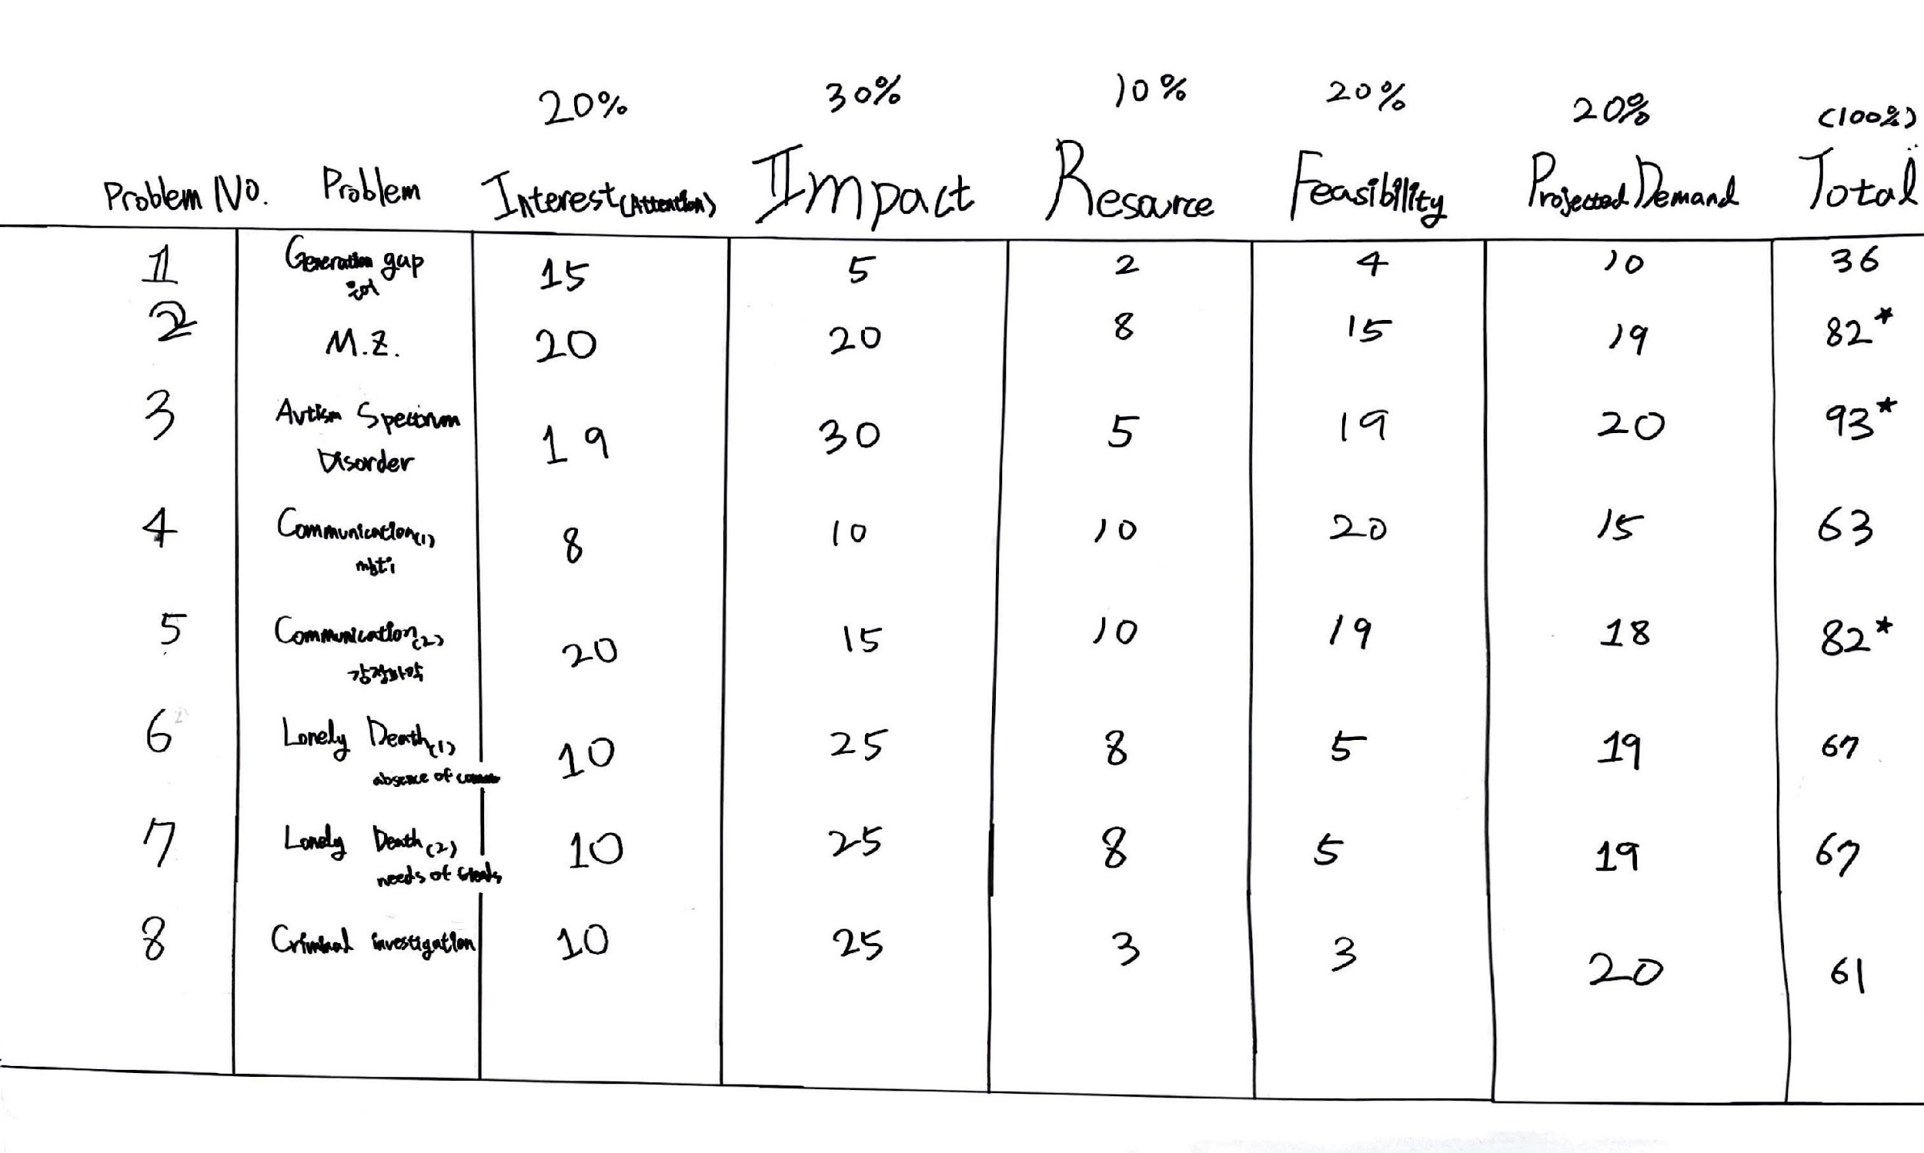
1. Why we need the problem solving
1-c. Current Status

Slide 8
1. Why we need the problem solving
1-c. Current Status
a. Elderly people find it difficult to understand slang.
 | Existing solution | Limitation of Existing solution | Solution by Software | Customer Expectation | Total Score
a. | Searching, Educational Programs or Workshops | Slang is constantly evolving. | Effective | Understanding slangs to communicate with youngs | 36

Slide 9
1. Why we need the problem solving
1-c. Current Status
b. Hard to communicate with workspace superiors.
 | Existing solution | Limitation of Existing solution | Solution by Software | Customer Expectation | Total Score
b. | Books, Counseling communication skill | Results may vary depending on individuals. | Not sure | Understand what one’s superior requires and why | 82

Slide 10
1. Why we need the problem solving
1-c. Current Status
c. Difficulty in understanding others’ emotions innately.
 | Existing solution | Limitation of Existing solution | Solution by Software | Customer Expectation | Total Score
c. | EQ training, memorizing the facial expression, etc. | Take too much time. Some might have inherent limitations. | Effective | For smooth communication with others | 93

Slide 11
1. Why we need the problem solving
1-c. Current Status
d. Analyzing the other person’s tendencies through communication.
Problem | Existing solution | Limitation of Existing solution | Solution by Software | Customer Expectation | Total Score
d. | MBTI, MMIP, STRONG, MLST-II, FCPI etc.(tests) | The participation of the target is required. | Not Effective | To gain a deeper understanding of the other. | 63

Slide 12
1. Why we need the problem solving
1-c. Current Status
e. Elderly people struggle to understand the emotions of other in chats through platforms like KakaoTalk.
Problem | Existing solution | Limitation of Existing solution | Solution by Software | Customer Expectation | Total Score
e. | NONE |  | Effective | To communicate more smoothly with the young. | 82

Slide 13
1. Why we need the problem solving
1-c. Current Status
f. Absence of communication & lack of friends occurs lonely death.
Problem | Existing solution | Limitation of Existing solution | Solution by Software | Customer Expectation | Total Score
f. | Apps for one-person -household, Policies | Cannot fulfill the hearts of lonely people. | Effective | Friends to communicate and a word of comfort | 67

Slide 14
1. Why we need the problem solving
1-c. Current Status
g. Criminal psychological analysis is not easy
Problem | Existing solution | Limitation of Existing solution | Solution by Software | Customer Expectation | Total Score
g. | Professional people’s analysis | Takes too much time. | Effective | Due to the shortage of criminal psychology experts, there is a need for tools to increase analysis efficiency. | 61

Slide 15
1. Why we need the problem solving
1-d. Market Forecast
Problem | Problem Description | Expected Market Size | Reason
a. | Elderly people find it difficult to understand slang. | Small | Elderly people have little interest in information about the latest apps, and it is difficult to provide features more convenient than alternative search engines.
b. | Hard to communicate with workspace superiors. | Big | It's because it's a concern for almost all employees.
c. | Difficulty in understanding others’ emotions innately. | Medium | Although the number of people facing pioneering issues such as autism spectrum is small, solutions are essential for them.
d. | Analyzing the other person’s tendencies through communication. | Small | It is difficult to replace existing solutions due to the tradeoff between convenience and performance.
e. | Elderly people struggle to understand the emotions of other in chats through platforms like KakaoTalk. | Small | Elderly people have little interest in information about the latest apps, and it is difficult to provide features more convenient than alternative search engines.
f. | Absence of communication & lack of friends occurs lonely death. | Big | This is because the number of people at risk of dying alone is increasing due to the aging population and the rise in single-person households.
g. | Criminal psychological analysis is not easy. | Medium | This is because, depending on the convenience of the solution to the problem, criminal psychology analysis can be widely used even for non-serious crimes.

Slide 16
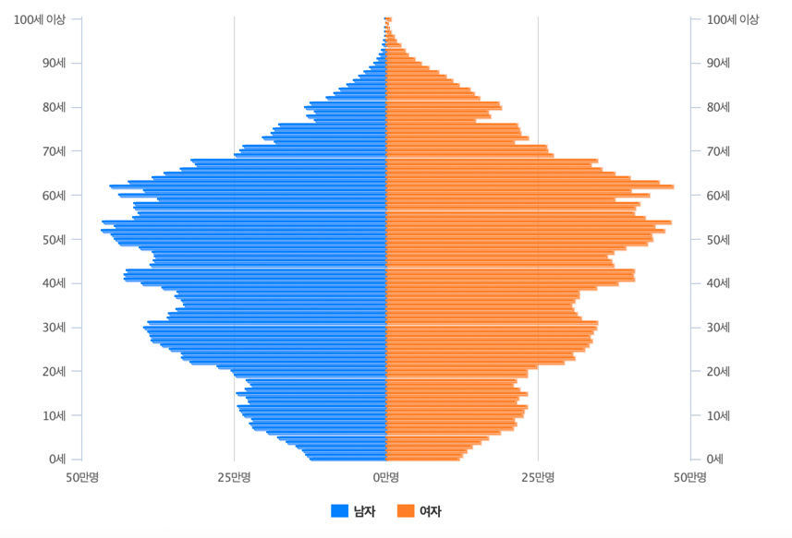
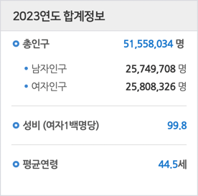
1. Why we need the problem solving
1-d. Market Forecast
Korean Population Pyramid, KOSIS, https://sgis.kostat.go.kr/jsp/pyramid/pyramid1.jsp

Slide 17
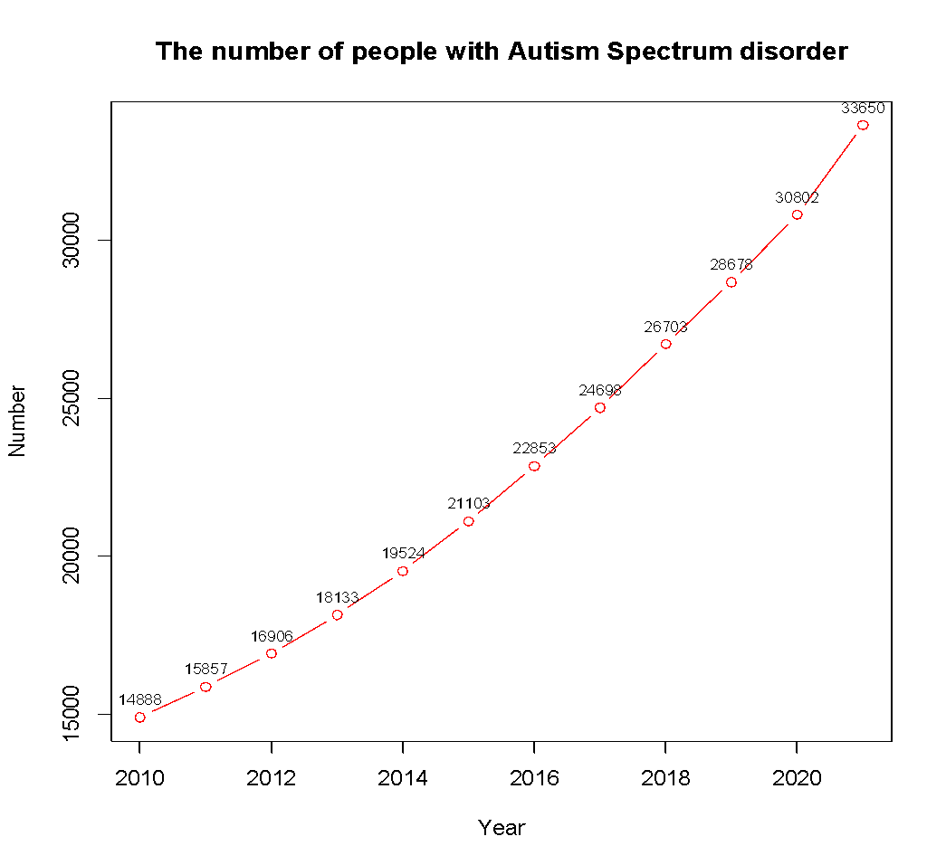
1. Why we need the problem solving
1-d. Market Forecast
The number of people with autism spectrum disorder, KOSIS,
https://kosis.kr/statHtml/statHtml.do?orgId=117&tblId=DT_11761_N003

Slide 18
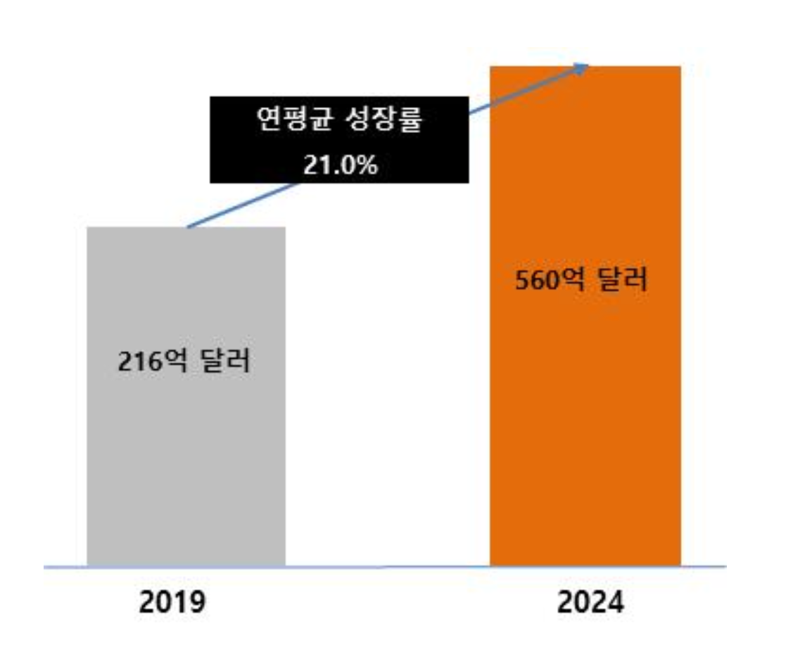
1. Why we need the problem solving
1-d. Market Forecast
Emotion Detection and Recognition Market Size Expectation
<MarketsandMarkets, Emotion Detection and Recognition Market, 2020>

Slide 19
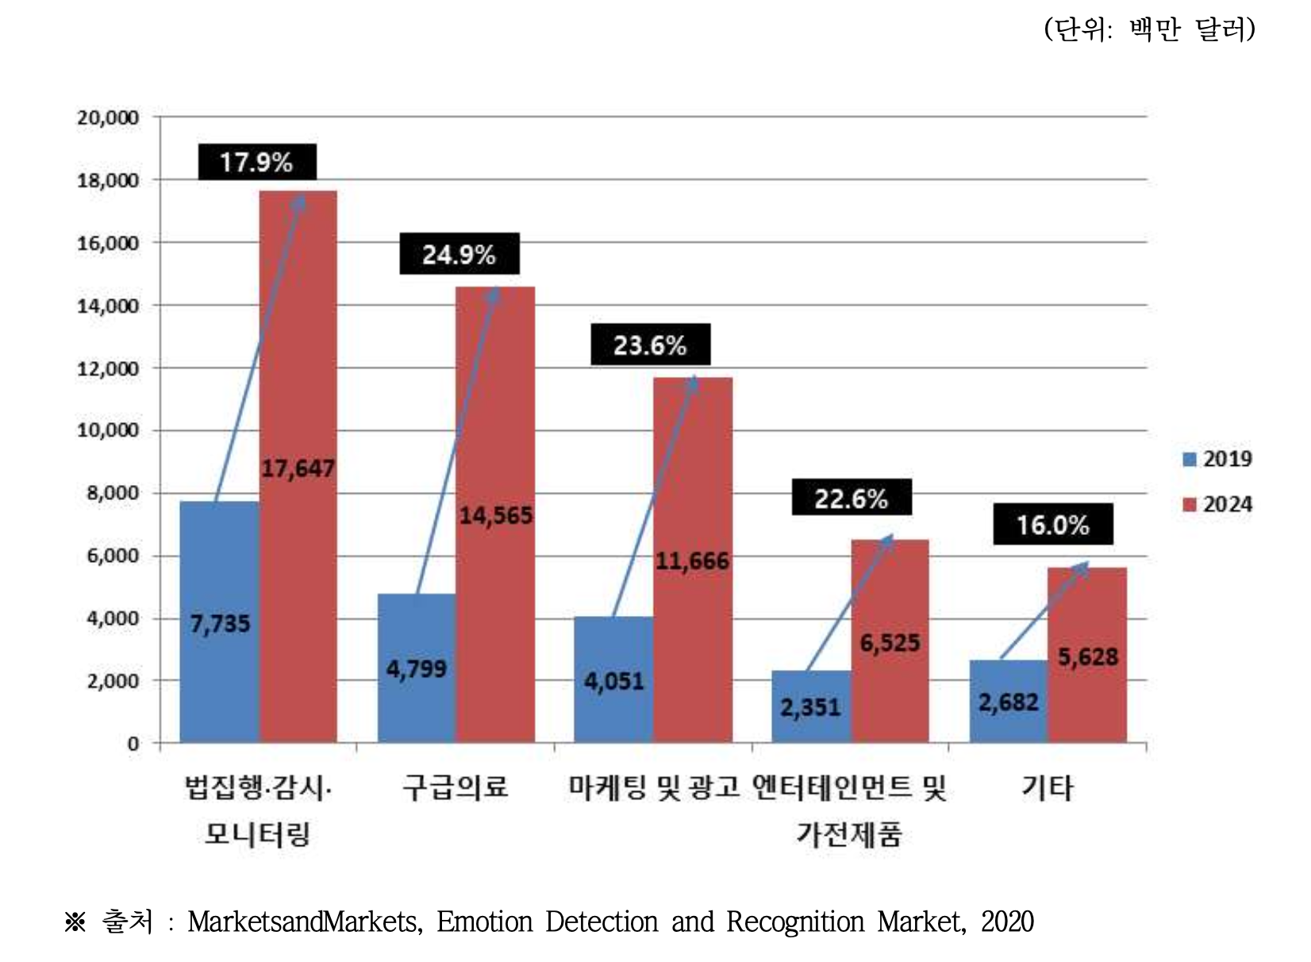
1. Why we need the problem solving
1-d. Market Forecast
Emotion Detection and Recognition Market Size and Outlook by Activity Area
<MarketsandMarkets, Emotion Detection and Recognition Market, 2020>

Slide 20
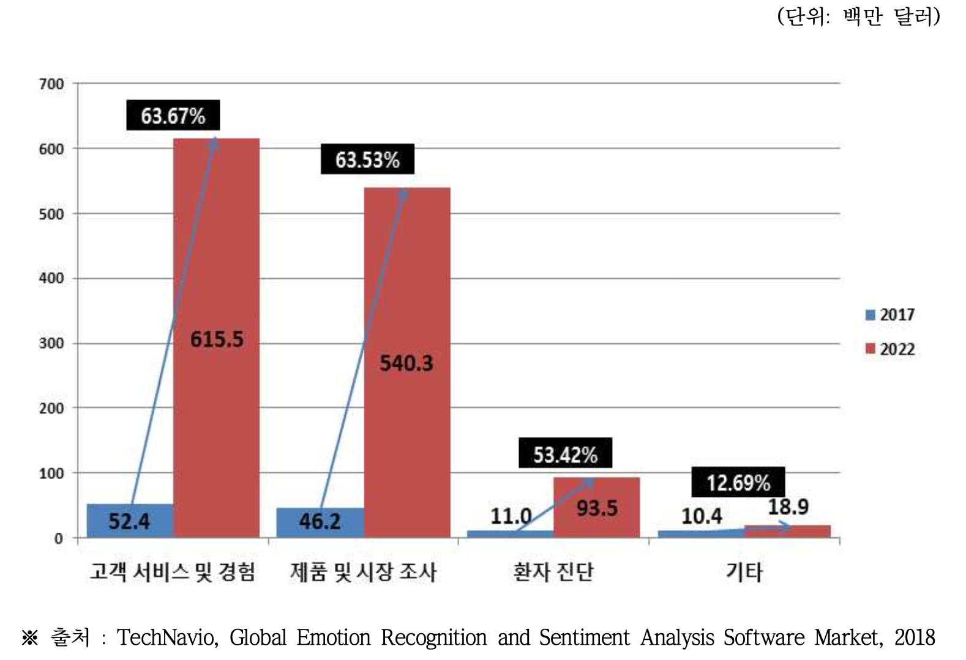
1. Why we need the problem solving
1-d. Market Forecast
Software Market Size and Outlook of Global Emotion Recognition and Analysis
<TechNavio, Global Emotion Recognition and Sentiment Analysis Software Market, 2018>

Slide 21
2. Solution Proposal
2-a. Solution Overview
communication
text-based communication
human relationships & interactions
various limitations or problems
Solution 1. An application that analyzes text through machine learning and expresses it with emoticons when using SNS in real time.
Solution 2. An application that translates slang into standard language.
Solution 3. A consolation chatbot application mainly outputs emotional language.

Slide 22
2. Solution Proposal
2-b. Focusing part and why
Improved Communication
result in more effective communication and less confusion.
Increased Engagement
the use of emoticons is a popular trend in social media communication.
Accessibility
important for people with disabilities or language barriers.
Business Profitability
through continuous diversification of emoticons, a paid policy can be used.

Slide 23
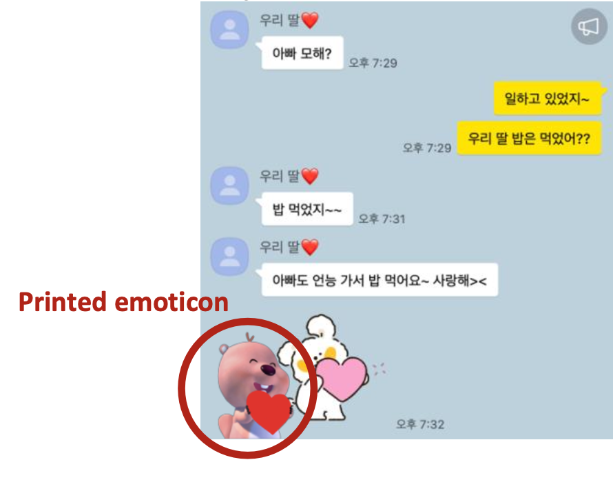
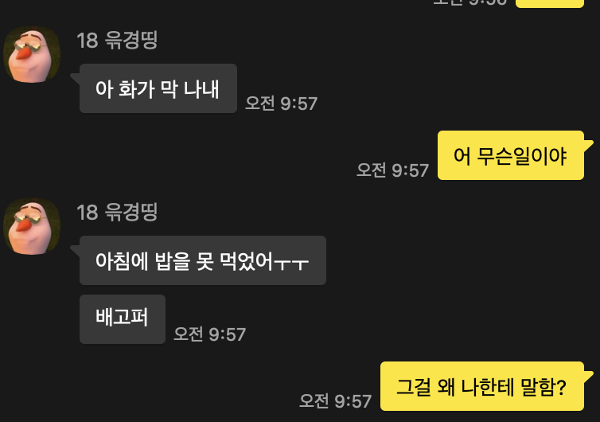

2. Solution Proposal
2-c. KPI - KGI (Key Goal Indicator) / End Product

Slide 24
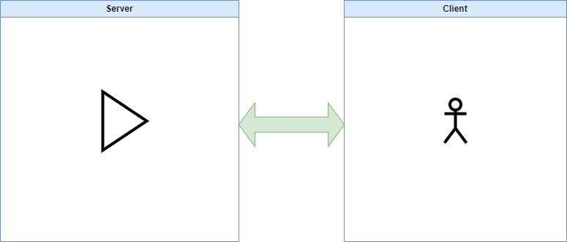
2. Solution Proposal
2-c. KPI - Designing Architecture
1. Client Server Computing :

Slide 25
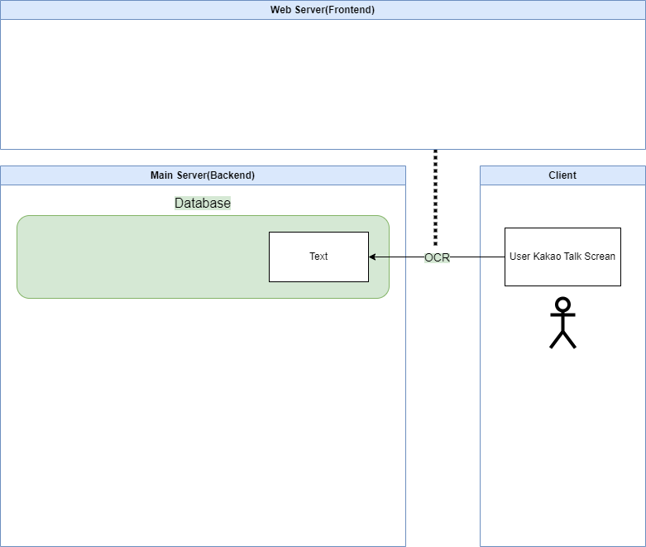
2. Solution Proposal
2-c. KPI - Designing Architecture
2. Optical Character Recognition

Slide 26
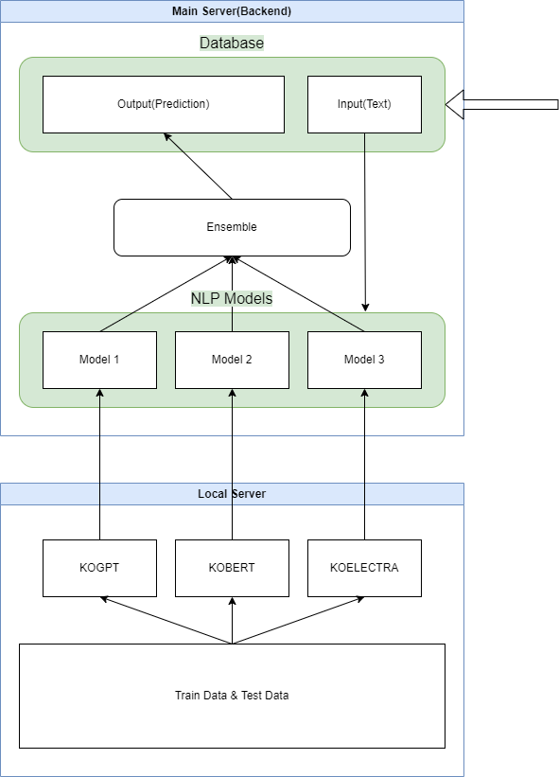
2. Solution Proposal
2-c. KPI - Designing Architecture
3. Natural Language Processing

Slide 27
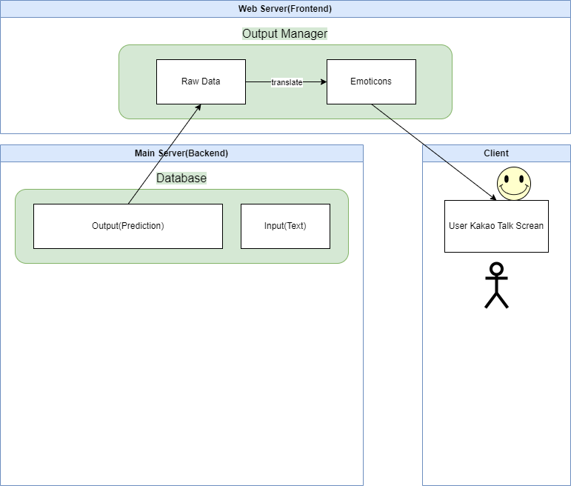
2. Solution Proposal
2-c. KPI - Designing Architecture
4. Output Manager Software

Slide 28
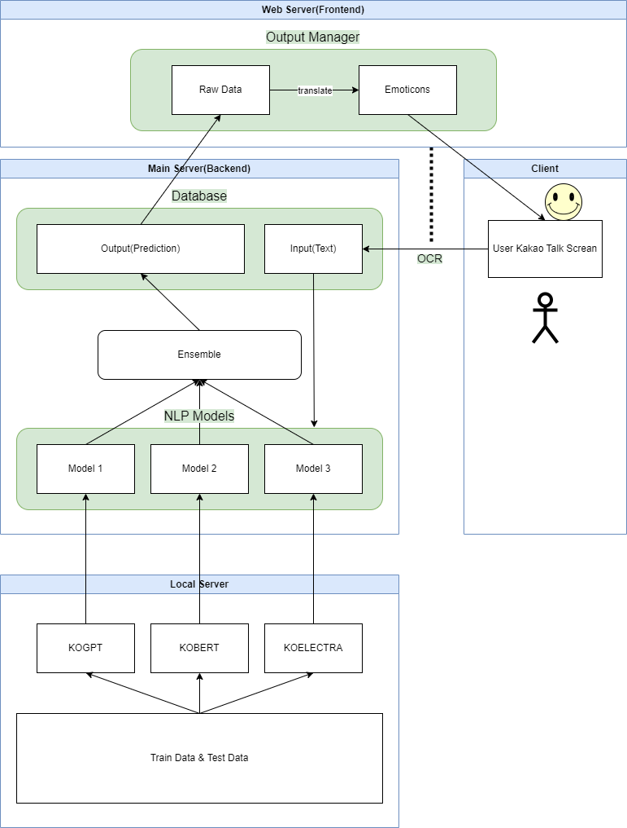
2. Solution Proposal
2-c. KPI - Designing Architecture
Final Architecture of Program

Slide 29
2. Solution Proposal
2-c. KPI - Designing Architecture
Final Architecture of Program

Slide 30
2. Solution Proposal
2-c. KPI - ML
Model Name | Type | Developer | Characteristic | OpenSource Link
ETRI KoBERT | BERT | ETRI | 한국어 전용 BERT 모델 | https://github.com/kiyoungkim1/LMkor
ETRI KoGPT-2 | GPT-2 | ETRI | 한국어 전용 GPT-2 모델 | N/A
SKT KoGPT-2 | GPT-2 | SKT | 한국어 자연어 생성 태스크에 우수한 성능 | https://github.com/SKT-AI/KoGPT2
SKT KoBERT | BERT | SKT | 한국어 자연어 이해 태스크에 우수한 성능 | https://github.com/SKTBrain/KoBERT
KcBERT | BERT | Beomi | 한국어 특성을 고려한 토큰화 방식 사용 | https://github.com/Beomi/KcBERT
KoELECTRA | ELECTRA | Monologg | 한국어 자연어 이해 태스크에 우수한 성능 | https://github.com/monologg/KoELECTRA/blob/master/README_EN.md
KoNLPy | N/A | KoNLPy Team | 한국어 형태소 분석기 포함, 사전 학습 언어 모델은 아님 | https://github.com/konlpy/konlpy

Slide 31
2. Solution Proposal
2-c. KPI - ML
Metric | electra-kor-base | funnel-kor-base | KoGPT2 2.0 | XLM-Roberta-Base | KoELECTRA-Base | KoELECTRA-Base-v2 | KoBERT | HanBERT | kcbert-base | KoELECTRA-Base-v3 | albert-kor-base | bert-kor-base
NSMC (acc) | 91.29 | 91.36 | 89.1 | 89.03 | 90.33 | 89.56 | 89.59 | 90.06 | 89.87 | 90.63 | 89.45 | 90.87
Korean- Hate- Speech (F1) | 66.03 | 68.18 | N/A | 64.06 | 66.09 | 67.45 | 66.21 | 68.32 | 68.78 | 67.61 | 65.44 | 68.45

Slide 32
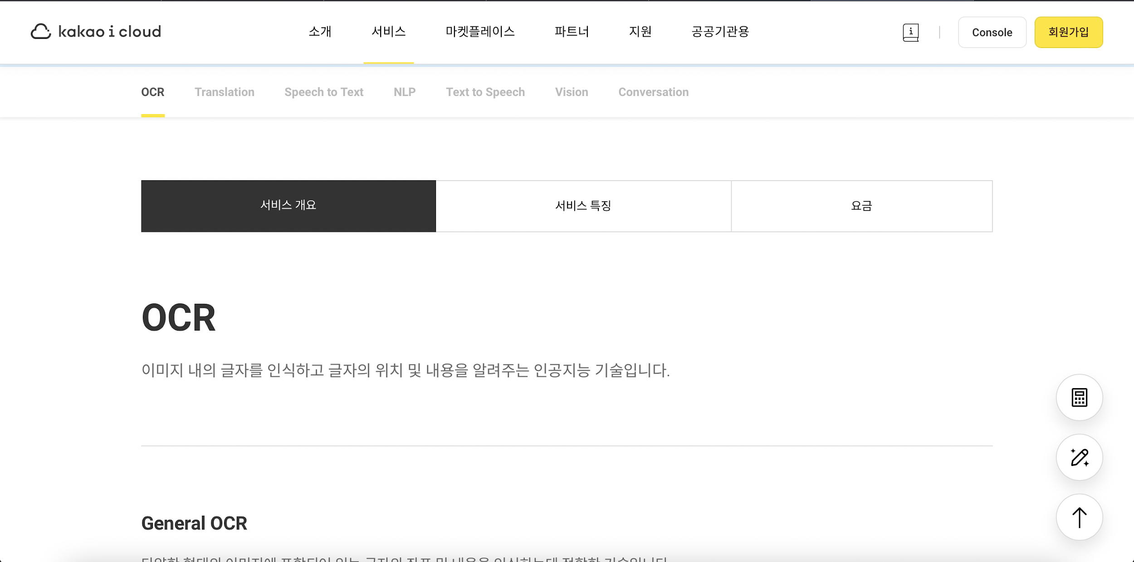
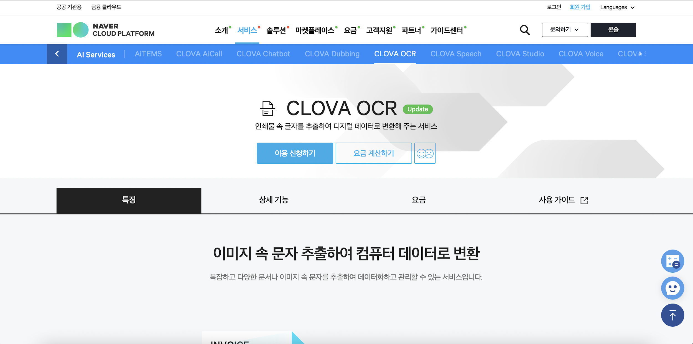
2. Solution Proposal
2-c. KPI - Frontend

Slide 33
2. Solution Proposal
2-c. KPI - Backend
in 1 sec!!!

Slide 34
3. Proposal of the implementation method
3-a. Capability matching
Name | Primary Programming Language | Experienced or Interesting Area
Jung WooSeop | Python | Machine-Learning / Front-End
Seo DongHwan | C/C++ | Embedded development
Baek MinJae | Python | Machine-Learning / Cloud computing
Lee DaBin | Python | Machine-Learning
Wi JungMyung | Python | Reinforcement-Learning / Computer vision
Current capability
Front-End development
Machine-Learning development
Required capability
Back-End development
Understanding of Client-Server architecture development

Slide 35
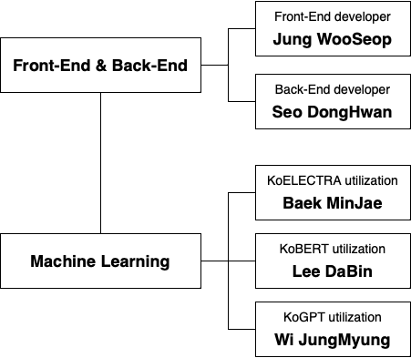
3. Proposal of the implementation method
3-b. Structure of the team development
Each member was assigned a role suitable for his or her experience or interests
Minimizing the gap according to his or her capabilities.

Slide 36
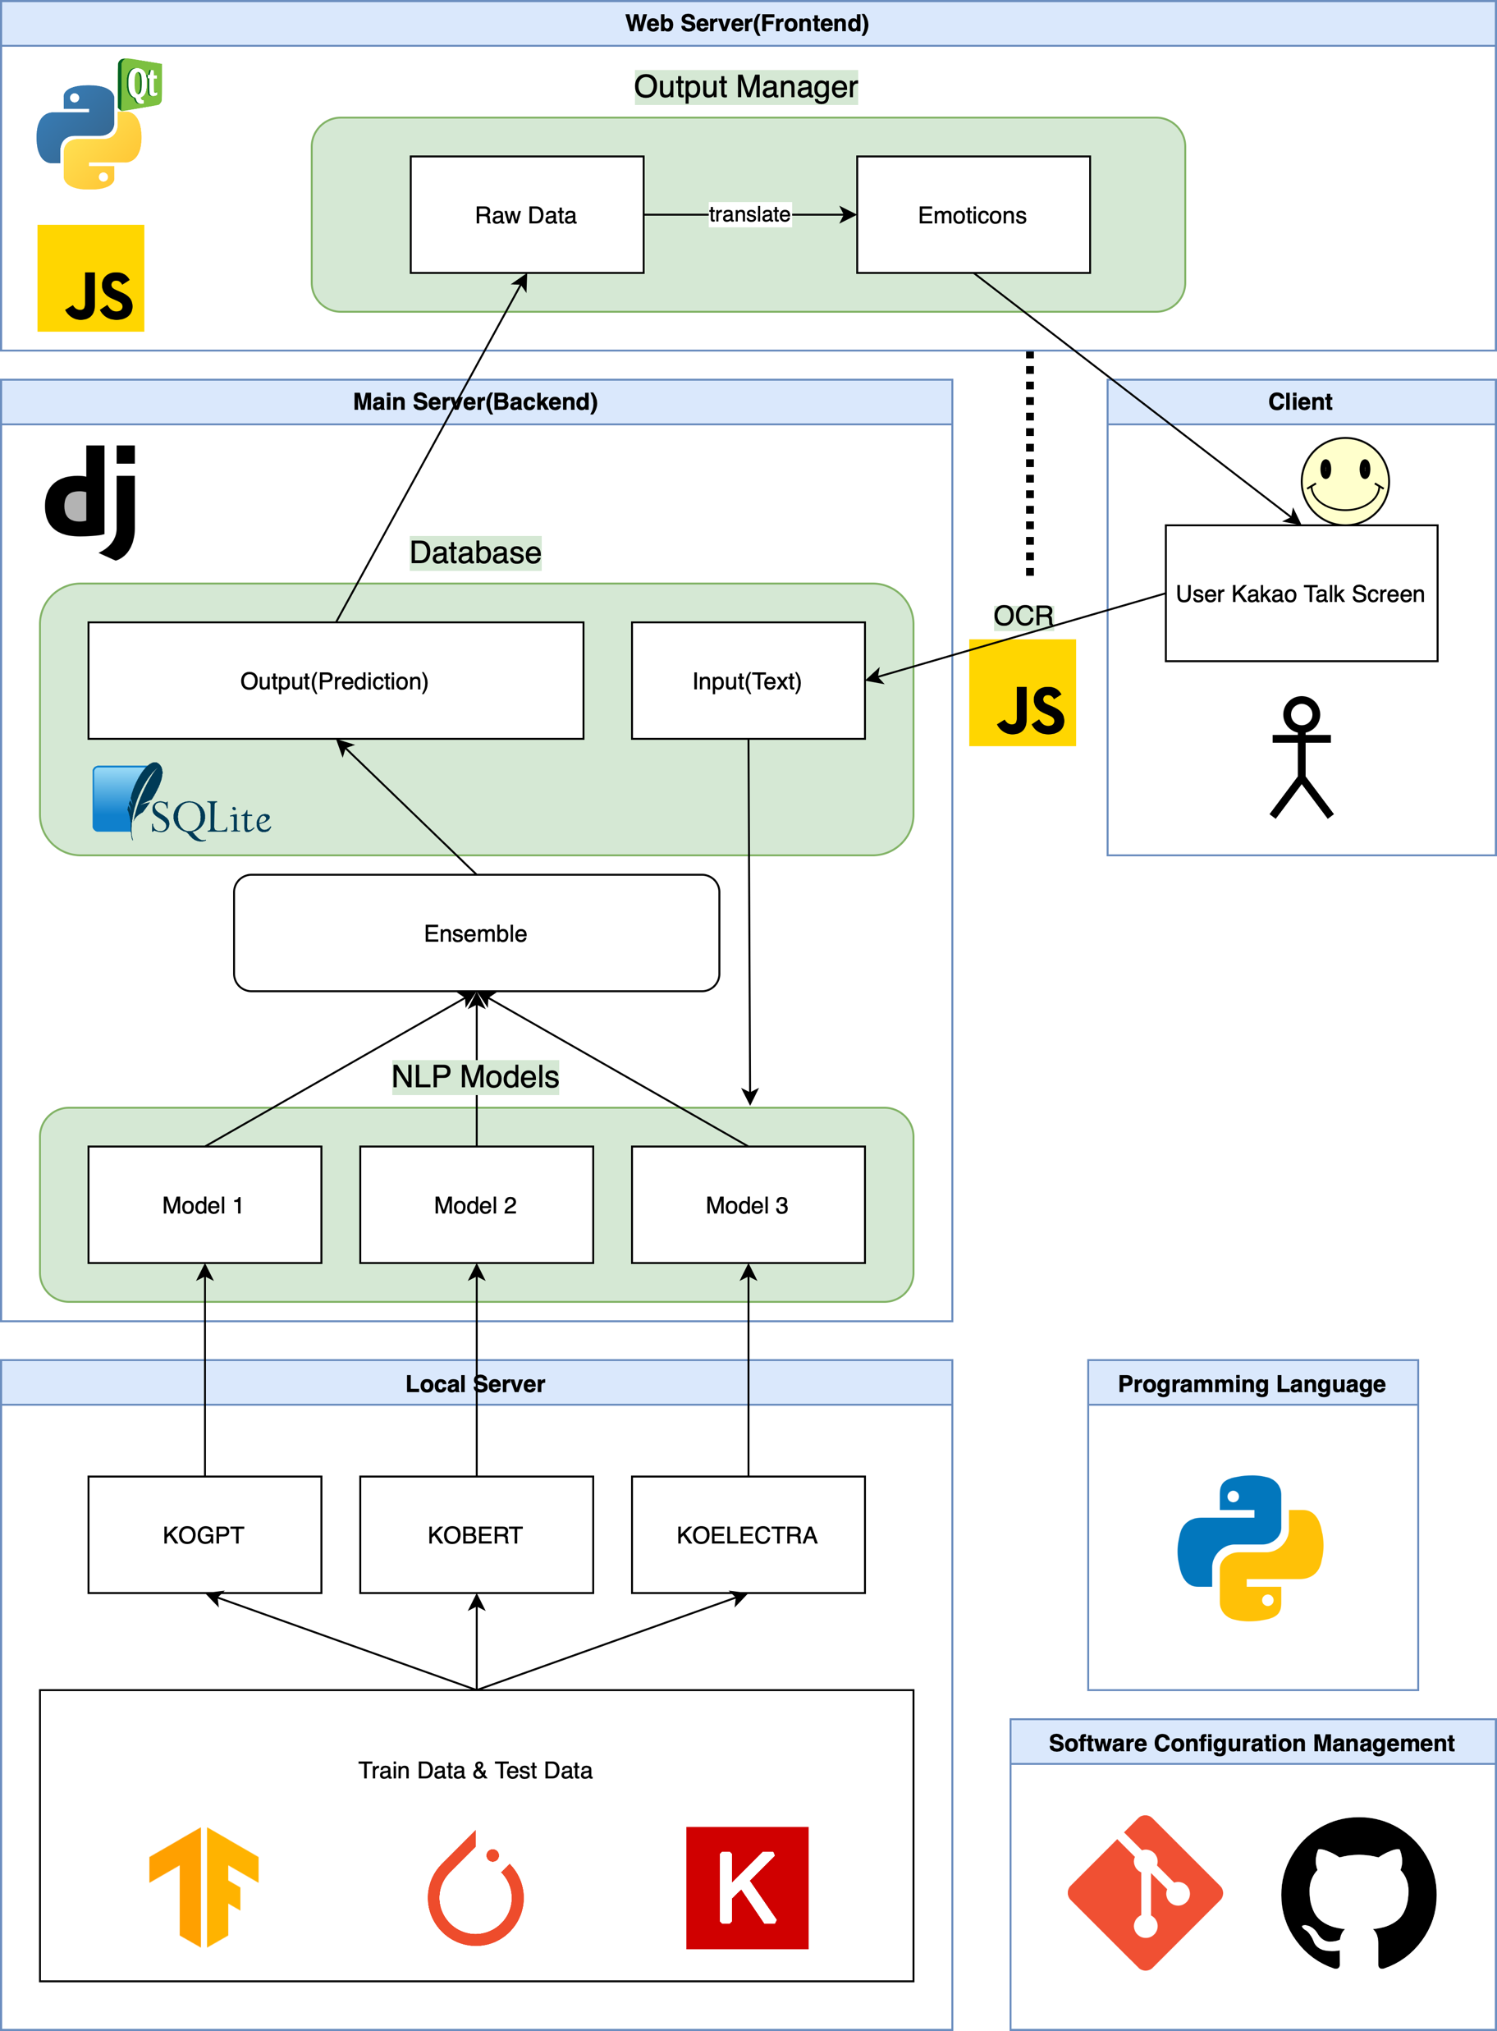
3. Proposal of the implementation method
3-b. Structure of the team development
Python based framework
Front-End
GUI
Conversation extraction(OCR)
Communication with Back-End
Back-End
Communication with Front-End
NLP model learning and deriving results method
Machine-Learning
Fine-tuning NLP models
Ensemble method of predictive values
Software Configuration Management
Development progress and source code

Slide 37
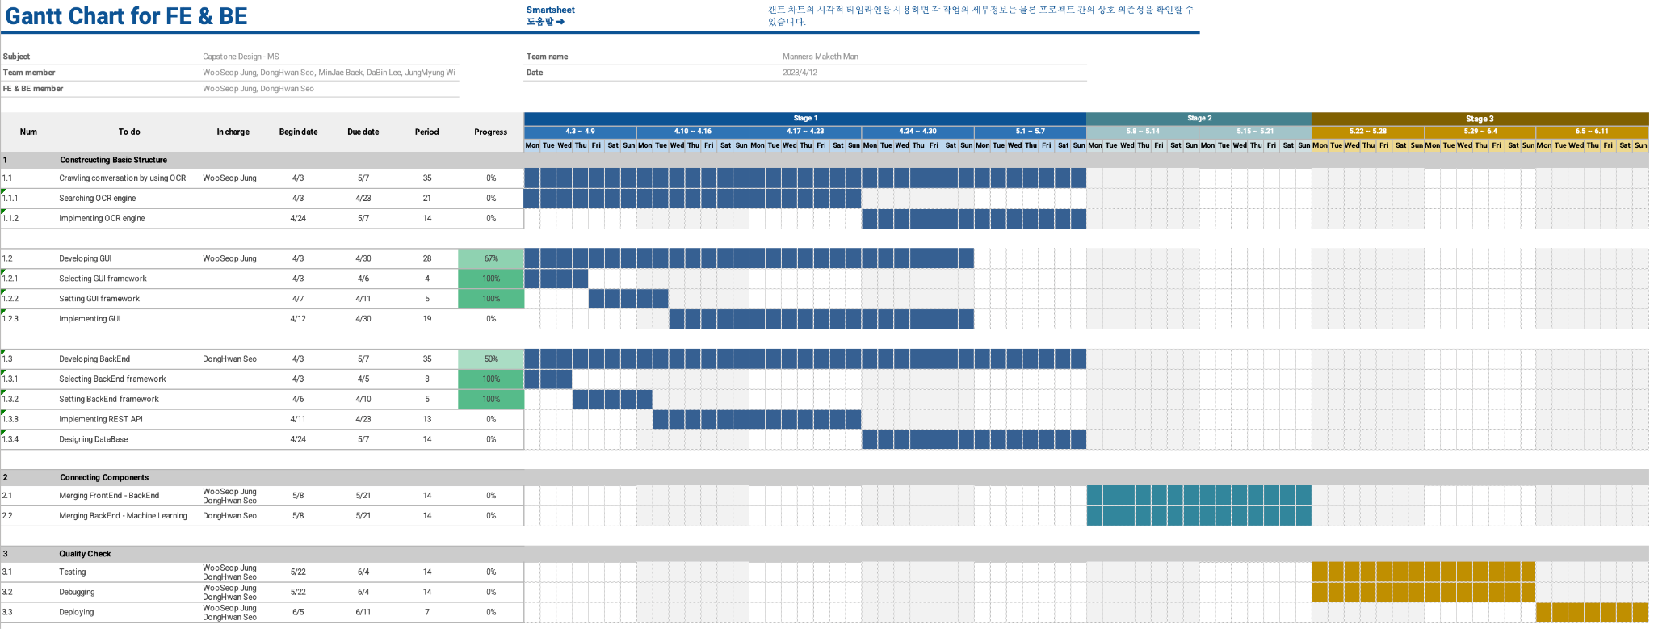
3. Proposal of the implementation method
3-c. Time plan

Slide 38
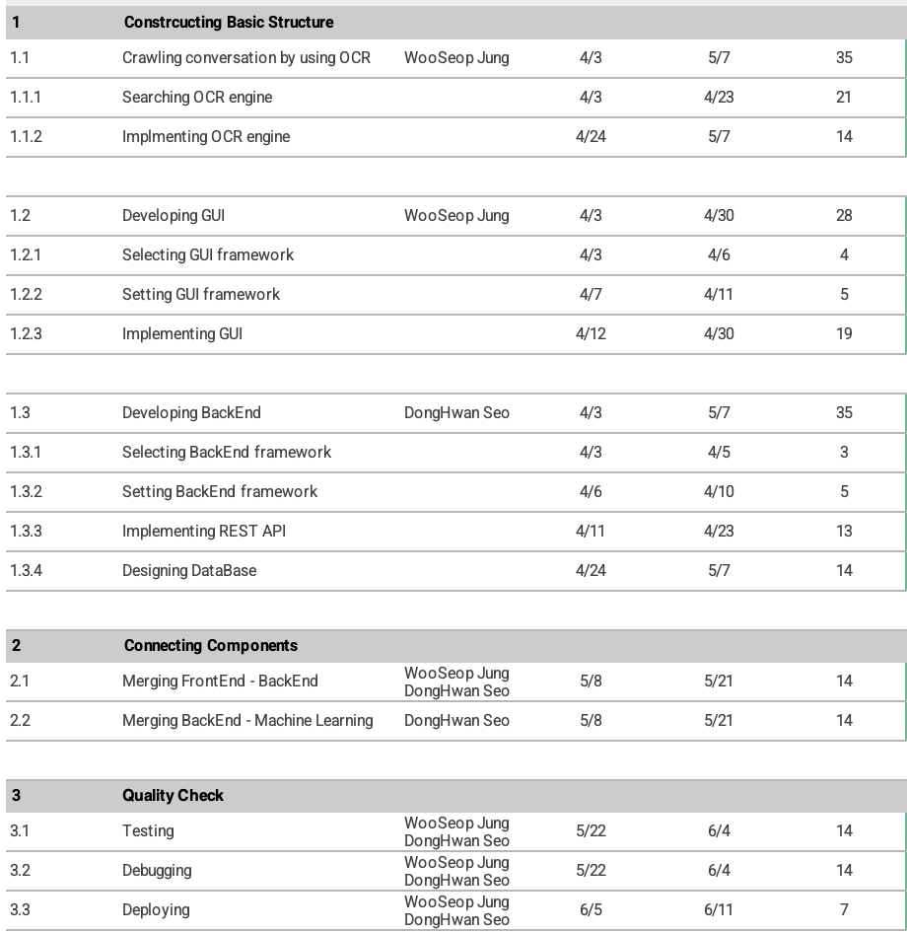
3. Proposal of the implementation method
3-c. Time plan

Slide 39
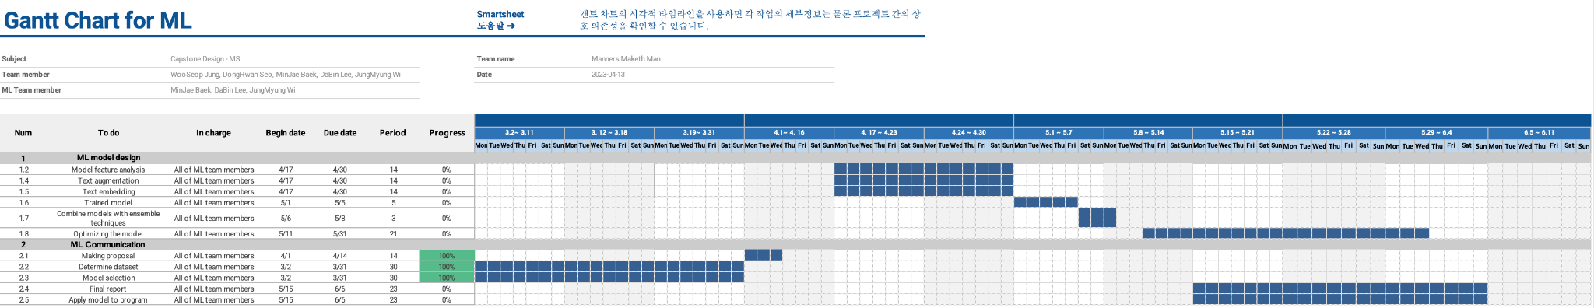
3. Proposal of the implementation method
3-c. Time plan

Slide 40
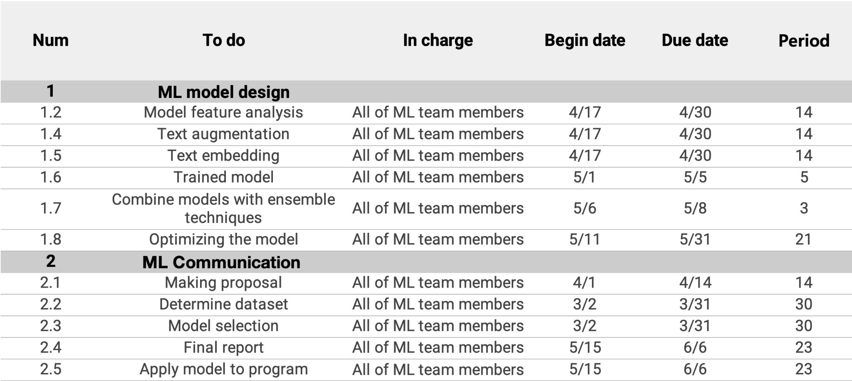
3. Proposal of the implementation method
3-c. Time plan

Slide 41
3. Proposal of the implementation method
3-d. Risk analysis and hedging
Minimizing the capability gap
Each member is assigned a role suitable for each experience or field of interest
Lack of web programming experience -> progress gap between FE, BE and ML
The part that finished development first will help the other part
ML models need high computing power
Performance of the application is sensitive with server’s computing power
Providing high-enough performance server
Optimizing connection methods with ML model
Privacy infringement due to conversation collection
In accordance with Article 24, Paragraph 1 of the Personal Information Protection Act, consent will be obtained for personal information processing, and chat history will be used lawfully.
Obtain consent from the user for the personal information processing policy when running the application for the first time

Slide 42
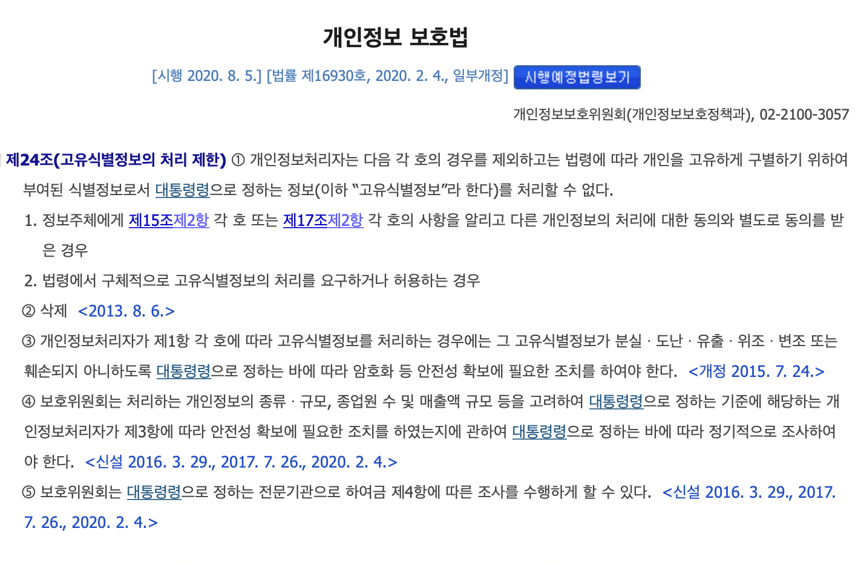
3. Proposal of the implementation method
3-d. Risk analysis and hedging
Minimizing the capability gap
Each member is assigned a role suitable for each experience or field of interest
Lack of web programming experience -> progress gap between FE, BE and ML
The part that finished development first will help the other part
ML models need high computing power
Performance of the application is sensitive with server’s computing power
Providing high-enough performance server
Optimizing connection methods with ML model
Privacy infringement due to conversation collection
In accordance with Article 24, Paragraph 1 of the Personal Information Protection Act, consent will be obtained for personal information processing, and chat history will be used lawfully.
Obtain consent from the user for the personal information processing policy when running the application for the first time

Slide 43
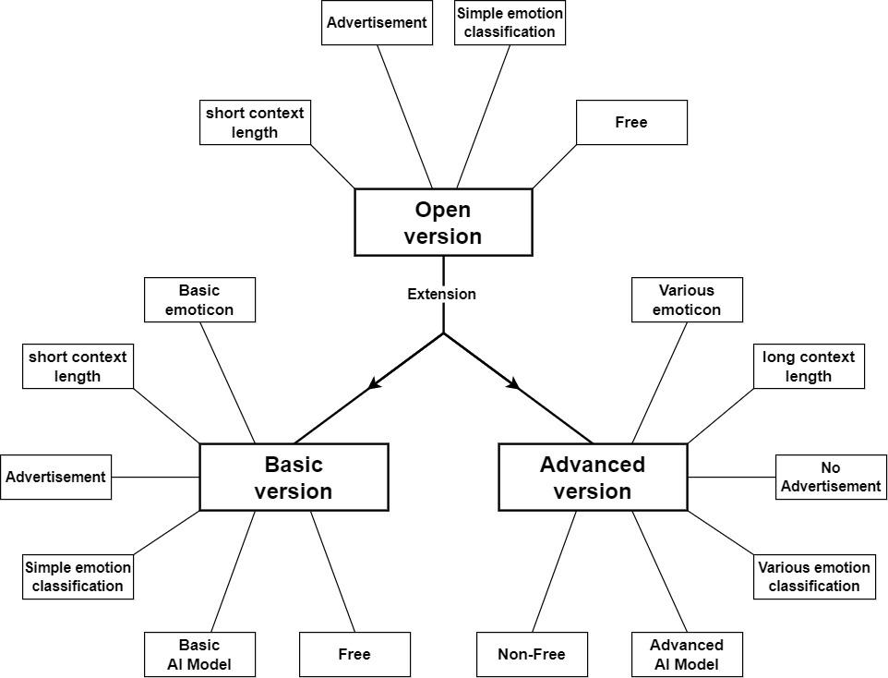
4. Utilization of the result
4-a. Marketing plan with target customers
<Marketing plan Diagram>

Slide 44
4. Utilization of the result
4-a-1. Open Version
Open Version (the goal of this project)
Open target : Target for everyone.
Price : Free to everyone
Performance : Simple emotion classification
Limited functionality : limited context length
Advertisement : maintenance for program(project)

Slide 45
4. Utilization of the result
4-a-2. Basic Version
Basic Version
Open target : Target for everyone.
Price : Free to everyone
Performance : Simple emotion classification
Limited functionality : limited context length
Advertisement : maintenance for program(project) Basic Emoticon : limited emoticon

Slide 46
4. Utilization of the result
4-a-3. Advanced Version
Advanced Version
Closed target : Customers to pay for service.
Price : Not for free (pay).
Performance : Various emotion classification.
Alleviated functionality : Longer context length than basic version.
No Advertisement : Maintenance for program(project). Various Emoticon : Can use various and customized emoticon.
Optimized model : Providing optimized AI model for specific customers.

Slide 47



4. Utilization of the result
4-a. Marketing plan with target customers (summary)
:
Time goes on
final goal
First goal
Extension
Advanced
open
basic

Slide 48


4. Utilization of the result
4-b. Impact analysis to industry/society
Medical Industry
Help people with
autism spectrum disorders
Psychotherapy

Slide 49


4. Utilization of the result
4-b. Impact analysis to industry/society
Business Fields
Improve team atmosphere
Improve customer satisfaction

Slide 50

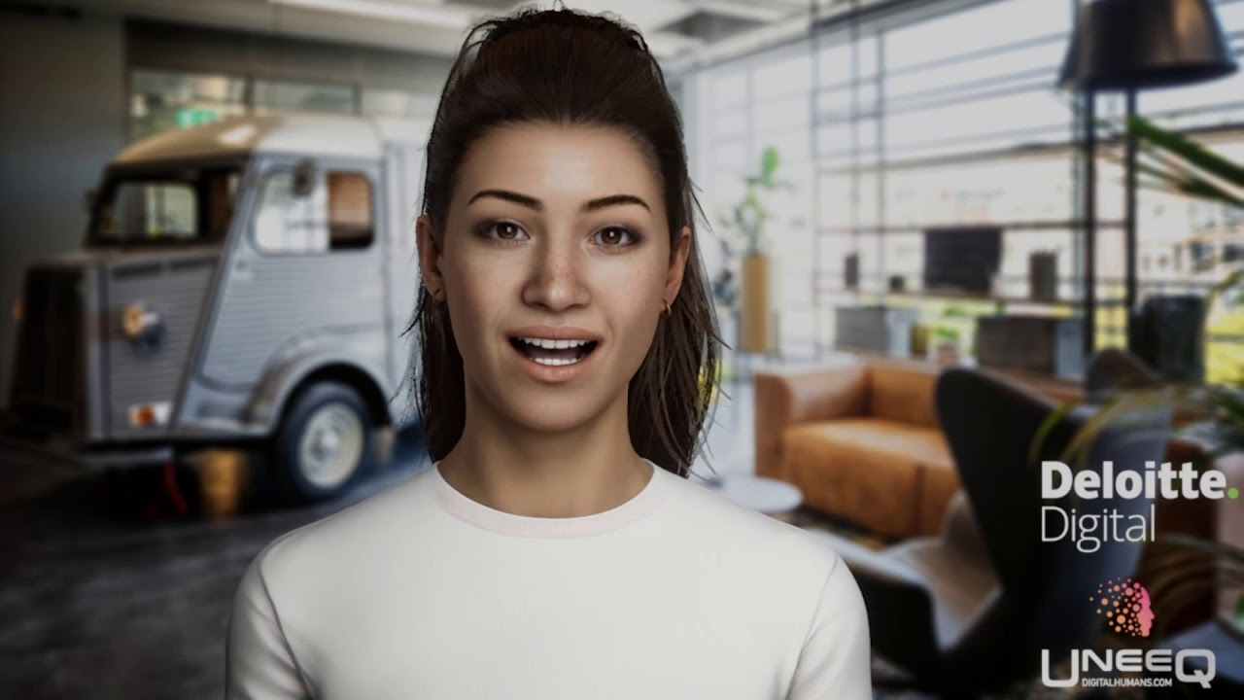
4. Utilization of the result
4-b. Impact analysis to industry/society
Digital Human Tech.
Daily Life
Help appropriate response
like real humans
Improve communication

Slide 51

4. Utilization of the result
4-b. Impact analysis to industry/society
Criminal Psychoanalysis
Models specialized in criminal sentiment analysis

Slide 52
Thank you

